Slide 1
Problem Solving Agent

Slide 2
Solving Problems by Searching
Reflex agent is simple
  base their actions on
  a direct mapping from states to actions
  but cannot work well in environments
    which this mapping would be too large to store
    and would take too long to learn
Hence, goal-based agent is used

Slide 3
Problem-solving agents
Problem solving agents are goal-directed agents:
Goal Formulation: Set of one or more (desirable) world states (e.g. checkmate in chess).
Problem formulation: What actions and states to consider given a goal and an initial state.
Search for solution: Given the problem, search for a solution --- a sequence of actions to achieve the goal starting from the initial state.
4. Execution of the solution
Note: Formulation feels somewhat “contrived,” but was meant
to model very general (human) problem solving process.

Slide 4
Goal formulation
The goal is formulated
  as a set of world states, in which the goal is satisfied
Reaching from initial state → goal state
  Actions are required
Actions are the operators
  causing transitions between world states
  Actions should be abstract enough at a certain degree, instead of very detailed
  E.g., turn left VS turn left 30 degree, etc.

Slide 5

Example: Path Finding problem
Formulate goal:
  be in Bucharest (Romania)
Formulate problem:
  action: drive between pair of connected cities (direct road)
  state: be in a city
  (20 world states)
Find solution:
  sequence of cities leading from start to goal state, e.g., Arad, Sibiu, Fagaras, Bucharest
Execution
  drive from Arad to Bucharest according to the solution
Initial
State
Goal
State
Environment: fully observable (map),
deterministic, and the agent knows
Effects of each action. Is this really the
case?
Note: Map is somewhat of a “toy” example. Our real interest: Exponentially large spaces, with e.g. 10^100 or more states. Far beyond full search. Humans can often still handle those!
One of the mysteries of cognition.

Slide 6
Search
Because there are many ways to achieve the same goal
  Those ways are together expressed as a tree
  Multiple options of unknown value at a point,
    the agent can examine different possible sequences of actions, and choose the best
  This process of looking for the best sequence is called search
  The best sequence is then a list of actions, called solution

Slide 7
Search algorithm
Defined as
  taking a problem
  and returns a solution
Once a solution is found
  the agent follows the solution
  and carries out the list of actions – execution phase
Design of an agent
  “Formulate, search, execute”

Slide 8
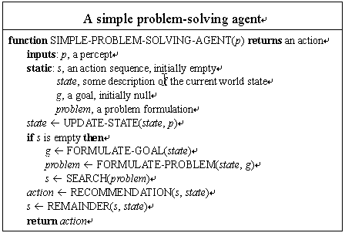
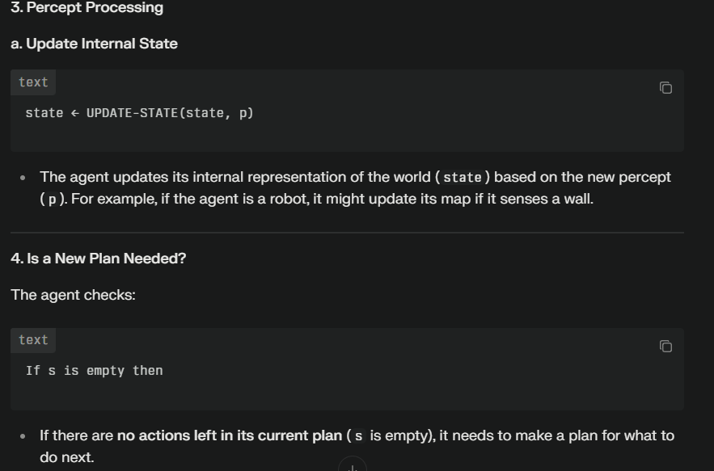
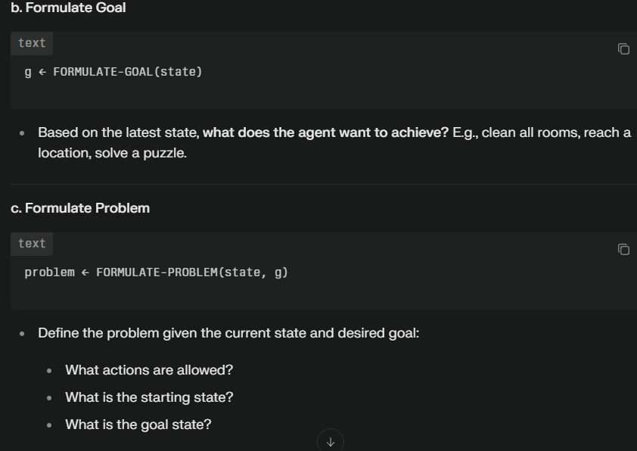
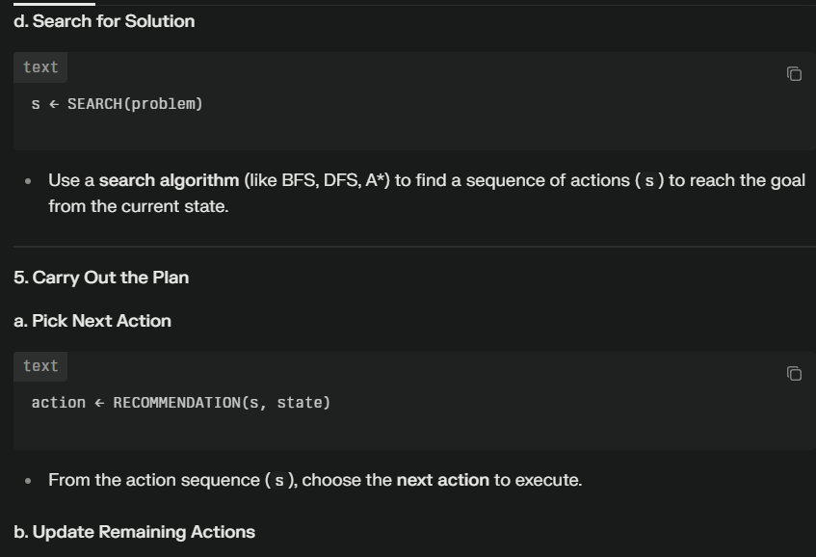
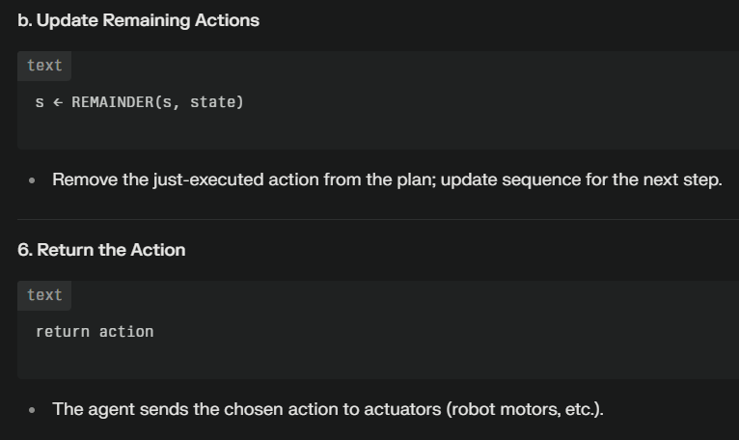

Slide 9
Problem types
1) Deterministic, fully observable
Agent knows exactly which state it will be in; solution is a sequence of actions.
2) Non-observable --- sensorless problem
  Agent may have no idea where it is (no sensors); it reasons in terms of belief states; solution is a sequence actions (effects of actions certain).
3) Nondeterministic and/or partially observable: contingency problem
  Actions uncertain, percepts provide new information about current state (adversarial problem if uncertainty comes from other agents).
  Solution is a “strategy” to reach the goal.
4) Unknown state space and uncertain action effects: exploration problem
    -- Solution is a “strategy” to reach the goal (end explore environment).
Increasing complexity

Slide 10
Well-defined problems and solutions
A problem is defined by 5 components:
Initial state
Actions
Transition model or (Successor functions)
Goal Test.
Path Cost.

Slide 11
Well-defined problems and solutions
  The initial state - that the agent starts in
  The set of possible actions
  Transition model: description of what each action does.
  (successor functions): refer to any state reachable from given state by a single action
  Initial state, actions and Transition model define the state space
  the set of all states reachable from the initial state by any sequence of actions.
  A path in the state space: any sequence of states connected by a sequence of actions.

Slide 12
Well-defined problems and solutions
The goal test
  Applied to the current state to test
    if the agent is in its goal
  -Sometimes there is an explicit set of possible goal states. (example: in Amman).
  -Sometimes the goal is described by the properties
    instead of stating explicitly the set of states
  Example: Chess
    the agent wins if it can capture the KING of the opponent on next move ( checkmate).
    no matter what the opponent does

Slide 13
Well-defined problems and solutions
A path cost function,
  assigns a numeric cost to each path
  = performance measure
  denoted by g
  to distinguish the best path from others
Usually the path cost is
  the sum of the step costs of the individual actions (in the action list)

Slide 14
Well-defined problems and solutions
Together a problem is defined by
  Initial state
  Actions
  Successor function
  Goal test
  Path cost function
The solution of a problem is then
  a path from the initial state to a state satisfying the goal test
Optimal solution
  the solution with lowest path cost among all solutions

Slide 15
Formulating problems
Besides the four components for problem formulation
  anything else?
Abstraction
  the process to take out the irrelevant information
  leave the most essential parts to the description of the states
  ( Remove detail from representation)
  Conclusion: Only the most important parts that are contributing to searching are used

Slide 16
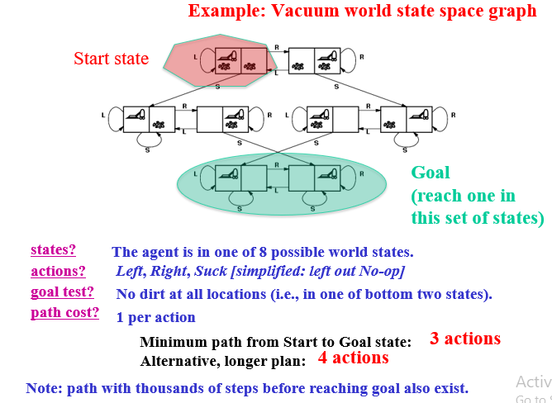
Vacuum world problem

Slide 17
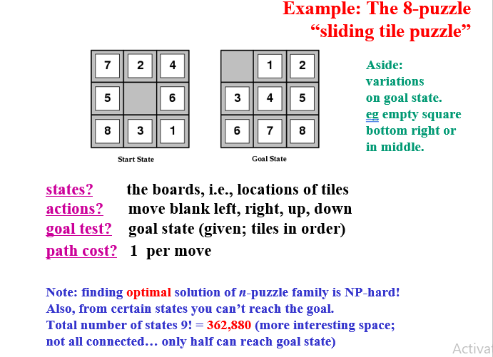
8 Puzzle problem

Slide 18
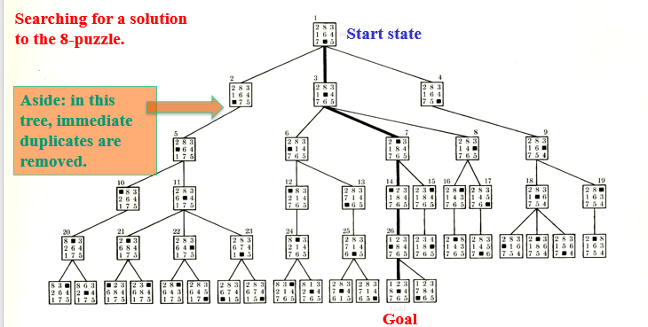
Searching 8 Puzzle problem

Slide 19
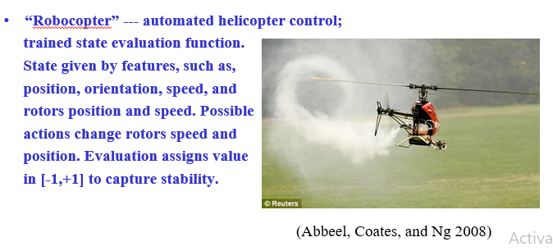
Robocopter

Slide 20
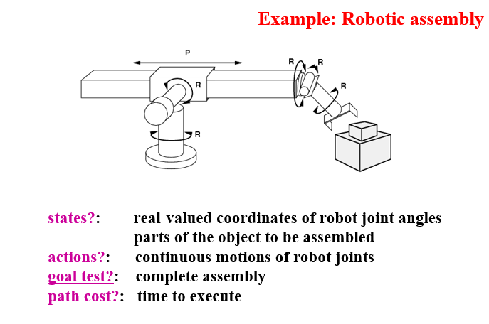
Robotic assembly

Slide 21
Other example search tasks
VLSI layout: positioning millions of components and connections on a chip to minimize area, circuit delays, etc.
Robot navigation / planning
Automatic assembly of complex objects
Protein design: sequence of amino acids that will fold into the 3-dimensional protein with the right properties.

Slide 22
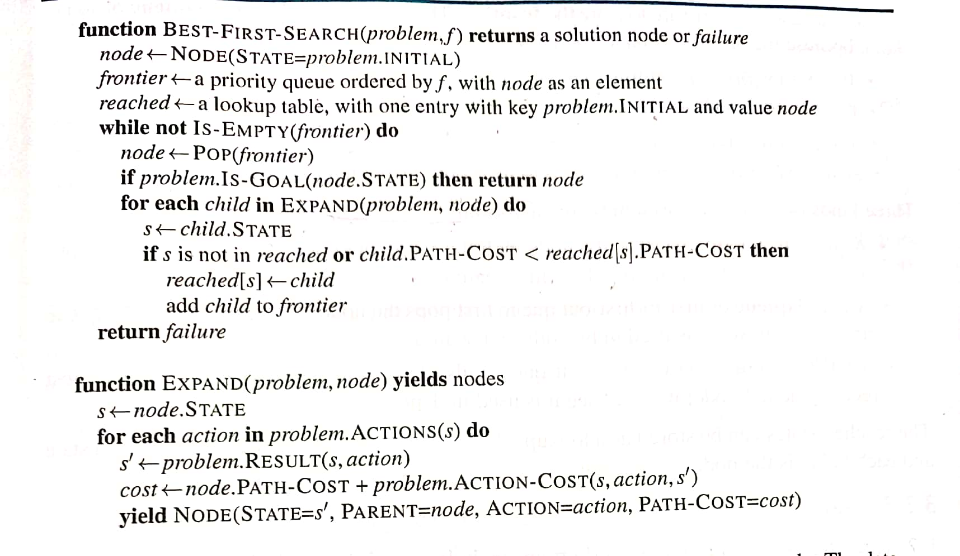
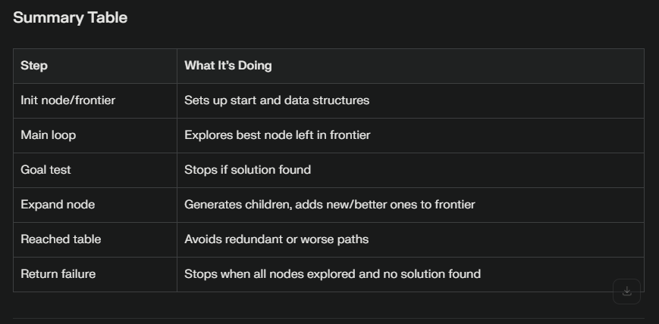
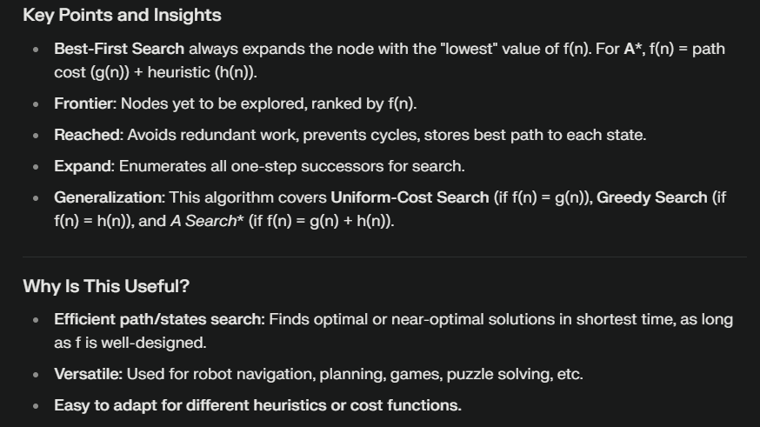
Best-First-Search

